Slide 1
Survivors of Polio & Their Families:
Triumphs of the Past & Challenges of the Present & Future
Hallie Baker, Ph.D., L.S.W
Associate Professor of Health Science
Muskingum University
September 15, 2018

Slide 2
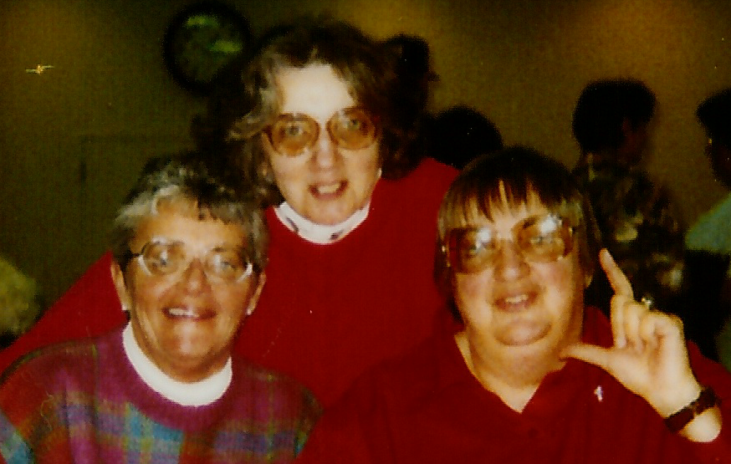
3 reasons why this topic is important to me

Slide 3
Guiding Frameworks
When examining the experiences of Polio Survivors and their families I use 2 theoretical frameworks:
  Life Course Perspective
  Life Course Disability Model

Slide 4
Life Course Perspective
4 Key pillars:
The individual life course is embedded and reflects to a significant degree the conditions, constraints, and opportunities of the historical context.
Human lives unfold over long periods of time & that experiences and conditions early in the life course set processes in motion that have long term consequences
Human lives are linked to other humans in complex ways and those connections are powerful forces in personal biography.
The power of human agency & conversely the rejection of an over socialized view of human lives.

Slide 5
Pillar #1 - Historical Context
The history of Polio & PPS are key to remember when:
  Understanding the unique characteristics of Polio survivors
  Examining social & family contexts
  Individuals and their families seek & are being provided care.

Slide 6
Polio – Important dates
April 12, 1955 Salk vaccine created – leads to the eradication of polio in the U.S.
Late 1970s, early 1980s
In the mid-1980’s

Slide 7
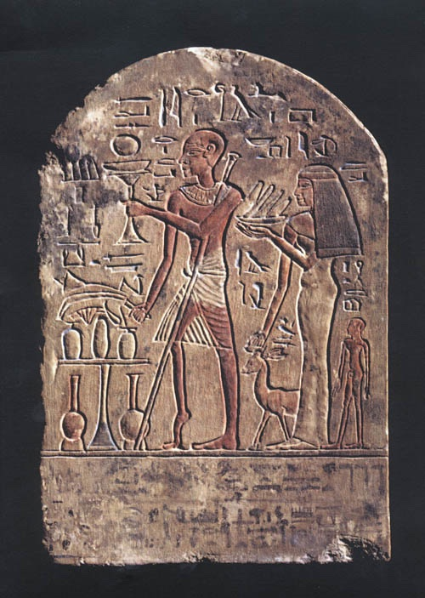
Polio – “Infantile Paralysis”
A disease that tended to strike the very young
Been around as long as human kind has, as this image from ancient Egypt shows
Also more prevalent in the summer months –
“Summer Grippe”

Slide 8
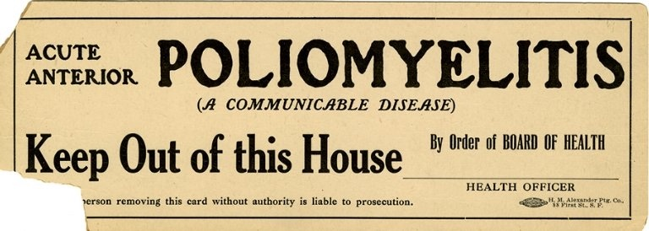
Polio – “Infantile Paralysis”
Beginning of 20th century infants (children less than 4 years of age) were the largest group infected
In 1952, an outbreak killed over 3,000 people and paralyzed over 21,000 in the U.S. alone.
Later it moved to older children up to their teens
Older children often suffered more destruction

Slide 9
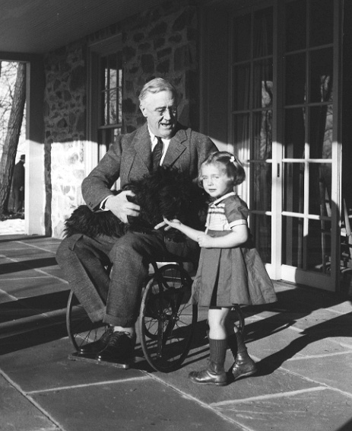
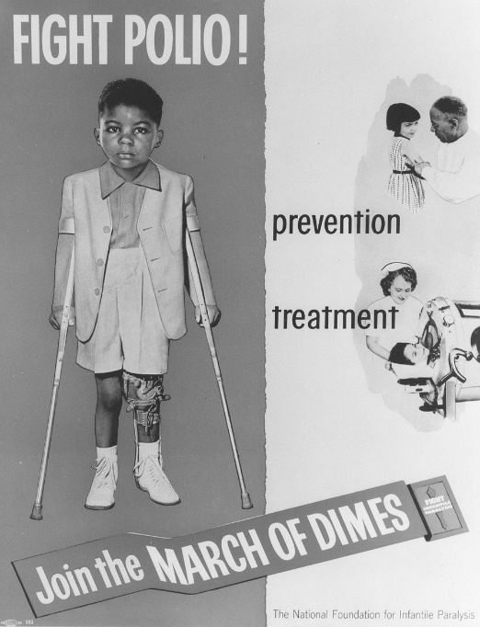
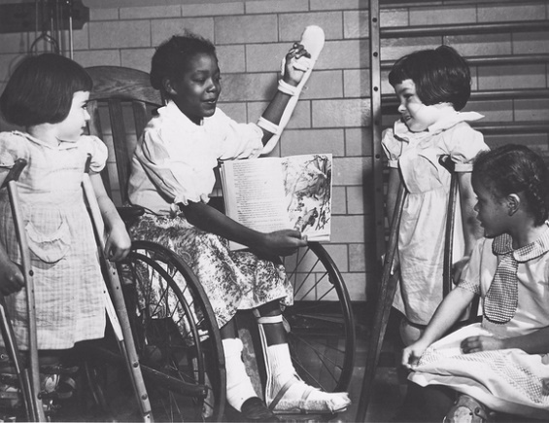
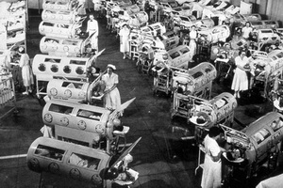
No one was safe though….

Slide 10
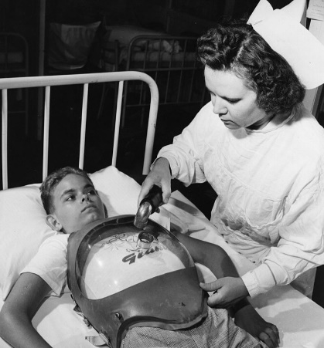
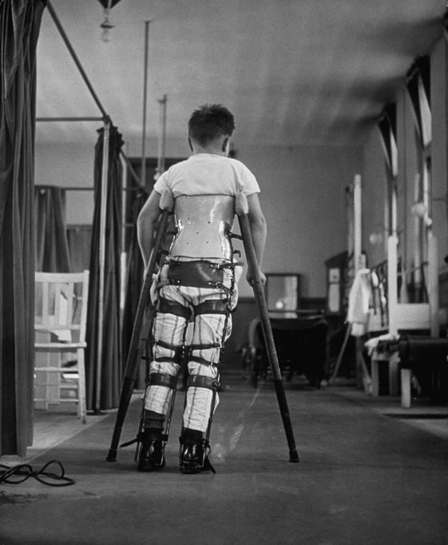
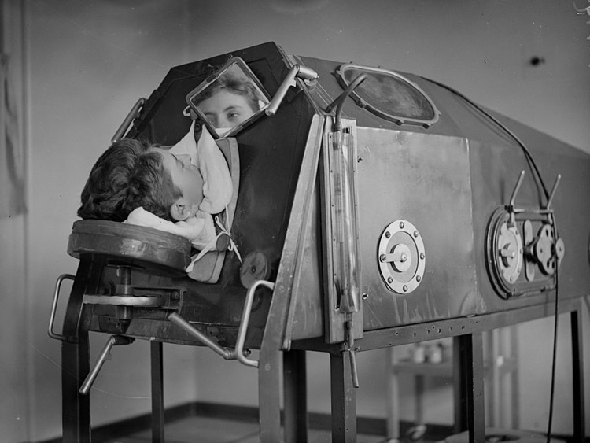
Polio infection – 2 types
Paralytic
  10% of all cases
  Symptoms included partial paralysis either temporary or permanent
  Commonly seen as ‘polio survivors’

Slide 11
Polio infection – 2 types
Non-Paralytic
  90% of all cases
  Mild case with fever and flu-like symptoms
  Appeared to make a full recovery

Slide 12
Polio – Rehabilitation
For survivors with paralysis, often a hospital served as the place of rehabilitation for months or years
  Some abuse took place
  Not the same care as what children today receive
Children reported “rules” to be followed including:
  “Listen to the Doctors,
  obey the nurses,
  do not fight,
  do not be bad,
  be good in school,
  do your homework,
  do not talk at dinner or in school,
  and little folks should be seen and not heard”.

Slide 13
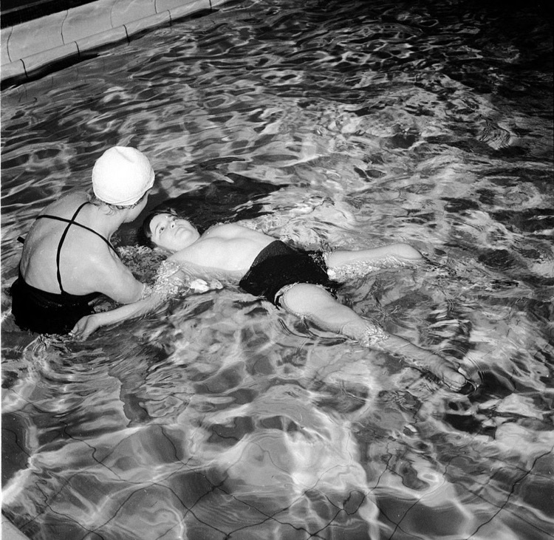
Polio – Rehabilitation
Treatments may not have been explained or poorly explained, also many were experimental treatments.
Think of a child with some paralysis being put in a pool for water therapy? How would you feel?

Slide 14
Polio – Rehabilitation
Result, many built a distrust of doctors and the medical community.
In general there was a strong push by the medical professionals, the community at large, and society for survivors to ‘get normal’
Remember this was pre-American’s with Disabilities Act.

Slide 15
Stigma of Polio
Many question why a family would have a child or children with polio
  In the past it could be a curse for “bad” behavior or sin
Later, having a child who wasn’t “normal” was not as acceptable

Slide 16
What this means:
For Family Members & Providers
  Must take their history into account
    How past interactions with the medical system has impacted them
    Type of polio they had

Slide 17
Pillar #2: long periods of time & early impacting late
These early experiences and historical contexts shaped how survivors coped with Polio
Many polio survivors worked very hard to overcome the damage hidden or obvious caused by the virus.
For those with non-paralytic polio the damage emerged years later as they grew in the form of skeletal issues such as shorter limbs, or spinal issues.
In a world that would not adapt to their needs, they had to adapt to it and appear “normal”

Slide 18
Polio – Coping styles
Maynard & Roller in 1991
Two counselors who identified 3 distinct coping styles among Polio Survivors:
  Passer
  Minimizer
  Identifier
  Let’s look at each of these in turn

Slide 19
Passers
survivors whose disability or weakness was so mild as to be easily hidden from the casual observer
hide their disability from those who were not intimate family members or friends

Slide 20
Minimizers
had/have a disability that is readily recognized by others
cope by focusing on other positives and work to get others to look beyond their disability by being high achievers who often push themselves to the limit
de-emphasizes the pain, deformity and functional short-comings, thereby tuning out their bodies or “devaluing physique”

Slide 21
Identifiers
due to being severly disabled by acute polio, “fully identify with their disability in order to make major lifestyle adaptations to sucessfully cope”
be high achievers, but instead of ignoring their disability like the other two groups, these individuals are advocates for the disabled

Slide 22
Coping styles & care
The styles provide an idea of how the individuals have coped over time, thus how he/she will likely tackle new issues
Have to build/deal with their coping styles
You must listen to what they have to say

Slide 23
Break time
I think we all need to stretch,
I’ll resume in 15 minutes

Slide 24
Evolution of PPS in mid-to later life
Post- Polio Syndrome
  Began emerging as a recognized issue in the early 1980s
  A condition diagnosed by elimination
  Polio survivors begin to show new muscle weakness or atrophy, increased fatigue and joint pain.
  Occurs from 10 to 40 years after initial polio infection

Slide 25
Early Treatments
Actually made it worse
Doctors started them on intense PT & OT with exercises, which just sped up the symptoms and wore out what was left faster
Now the key is “Conserve to Preserve”
Issue is psychological in some ways since all their lives they have struggled to appear “Normal” and push themselves, now they have to rest….

Slide 26
Survivors speak – 2 themes
Frustration
  frustration associated with their decreasing physical abilities.
  frustration with individuals outside their families who do not understand the symptoms of PPS.
  frustration with the medical community, particularly with doctors who were not familiar either with the original polio condition or Post Polio Syndrome.

Slide 27
Theme 2
Need for Control
  For most of their lives the individuals have hidden or controlled how polio impacted them, now they are loosing that control
  Express a wish that they be allowed to do what they need to in order to maintain the quality of life they want.
  Want their family members to help out when asked, not to take over

Slide 28
“That it is very depressing, awfully painful, hard to ask people to help you, You spend the majority of your life trying to hide a disability & now you can’t it’s too obvious. If we need to cry let us if we need help help us, try not to take our dignity away from us that is all we have”
“Fatigue, muscle weakness and not to say “we are all getting older” Also Doctors to at least try and understand PPS.”
“My family understand what has happened to me, however Drs, are not understanding at all, there are none I can use with my HMO in my area. I have big troubles with meds prescribed and if Drs were aware of what PPS people can tolerate would be a big help to me. this is going on to this day!”

Slide 29
“That this is a second “attack”, we have to learn to live with it and adjust and move on. It is pointless to try to “fight it”. Please understand I have been “fighting” it for the last 55 years, I’m tired of the battle and want to enjoy what I have left of my life.”
“Most of us have worked very hard all our lives to become independent. I was able to be that way all my life. Polio people have been pushed all their lives to be independent with PPS we are being told the opposite in some ways. some of us like myself who were very independent with mild cases of polio and now being hit very hard with PPS are having hard time adjusting to needing help and having to ask for it. After being told from a baby on from therapist and doctors ect. to push yourself and now having that body refusing to even pick up a 2 pound milk jug when for years you helped to take care of other people and children ect. Just to be patient its hard to make adjustments of 50 years of one way of doing things. of course when your body refuses it does help.”
“Back when I got sick, however, there were many who thought it was too bad that I didn’t die when I come down with polio, since there was no way I could live with any acceptable quality of life. I suppose that the main thing I’d like people to know is that “Quality of Life” is a very personal matter, and that no one should presume to judge that for another person. My quality of life has been immeasurable.”

Slide 30
For Providers & Families….
Repeat in some ways of the past where medical personnel didn’t listen to them
Increased mistrust as “treatments” made things worse.
Frustration with both medical care and their own bodies which are once again “failing” them

Slide 31
Pillar #3: Human Lives are Linked
We don’t go through life alone!
We have blood and fictive family.
The entire social network must be taken into consideration.

Slide 33
Pillar #4: Human Agency
Survivors and their families have voices!
Survivors have already overcome a lot.
Thus we cannot treat individuals all the same, each has unique needs, strengths and factors which influence them at any one point in time.

Slide 34
We tend to:
Focus only on the medical, the symptoms, but we need to go beyond that.
The disablement process reflects a bit of it, but I challenge providers and others to go farther with a Life Course Disability Model

Slide 35
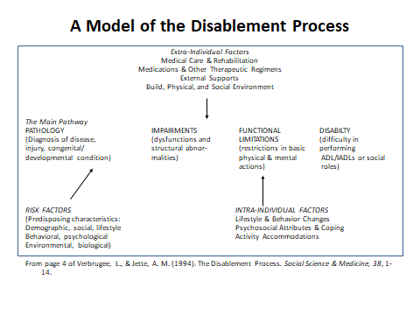

Slide 36
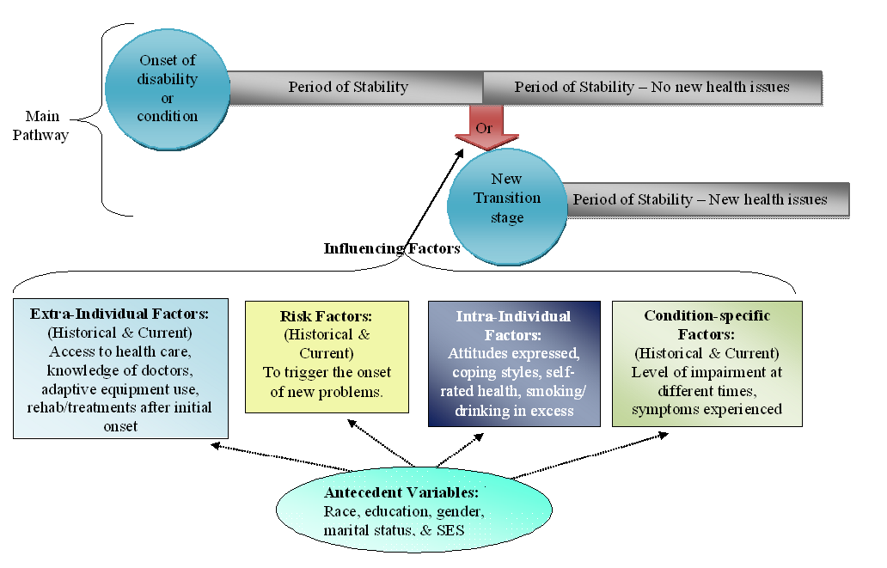
Life Course Disability Model

Slide 37
In the end……
Polio and PPS have historical contexts which influence survivors to this day.
Families need to realize what coping styles have worked in the past and how those might impact life now.
The whole network around a survivor must be examined and utilized.
We can’t forget the human spirit and what it means.

Slide 38
Finally…..
We need to look at the whole person, not just the physical
Build on the strengths!
Families and survivors need to be honest with each other to face the challenges ahead.

Slide 39
Questions?
Contact information:
Hallie Baker, Ph.D., L.S.W
Associate Professor of Health Science
Muskingum University
hallieb@Muskingum.edu
740-826-8350

